Slide 1
ANURAG UNIVERSITY DEPARTMENT OF INFORMATION TECHNOLOGY III B-TECH I-SEMISTER [2020-2024] MACHINE LEARNING AND IT’S APPLICATIONS PROJECT – II
TITLE : PARKINSON’S DISEASE DETECTION
Submitted by:
CH.Sharath -21EG112A07
G.Chandu -21EG112A12
G.Dharanidhar - 21EG112a17
R.Bheemesh - 21EG112A44
CH.Srikar -22EG512A01

Slide 2
CONTENT:-
Problem statement
Approach
About Parkinson’s Disease Detection
Tools and Libraries used
Model
Advantages and disadvantages
Outcome
Acknowledgement
References
Conclusion

Slide 3
1.PROBLEM STATEMENT:
It’s a application which offers you the Parkinson’s Disease detection with more accuracy based on training data
2.APPROACH :
Tools
Web browser
Vs Code
Jupyter Notebook
LANGUAGE :
Python
Html
CSS
LIBRARIES :
Matplotlib
Numpy & Pandas
Sckit-learn
seaborn

Slide 4
Parkinson’s disease is a neurodegenerative disorder of centralnervous system that causes partial or full loss of motor reflexes,speech, behavior, mental processing, and other vital functions. It is generally observed in elderly people and causes disorders inspeech and motor abilities of 90% of the patients.People with Parkinson’s disease suffer from speech impairmentslike dysphonia (defective use of the voice), hypophonia (reducedvolume), monotone (reduced pitch range), and dysarthria(difficulty with articulation of sounds or syllables).In this project voice parameters of Parkinson’s disease patientsand healthy subjects will be analyzed to predict the presence ofParkinson’s disease.
Introduction
3. PARKINSON’S DISEASE DETECTION :
Parkinson’s disease is a neurodegenerative disorder of centralnervous system that causes partial or full loss of motor reflexes,speech,behavior, mental processing, and other vital functions. It is generally observed in elderly people and causes disorders inspeech and motor abilities of 90% of the patients.People with Parkinson’s disease suffer from speech impairments like dysphonia (defective use of the voice), hypophonia (reduced volume), monotone (reduced pitch range), and dysarthria(difficulty with articulation of sounds or syllables).In this project voice parameters of Parkinson’s disease patients and healthy subjects will be analyzed to predict the presence of Parkinson’s disease

Slide 5
4.Tools and Libraries:
Jupyter Notebook:
Browser-based interactive programming environment jupyternotebook (formerly ipython notebooks) is a web-based interactive computational environment for creating jupiter notebook documents.
VS Code:
Visual studio code is a lightweight but powerful source code editor which runs on your desktop and is available for windows,macOS and linux. Itccomes with built-in support for JavaScript,TypeScript and Node.js and has a rich ecosystem of extensions for other languages andruntimes (such as C++,C#,JAVA,PYTHON,PHP,Go,NET).
Scikit-learn:
Scikit-learn (Sklearn) is the most useful and robust library for machine learning in Python. It provides a selection of efficient tools for machine learning and statistical modeling including classification, regression, clustering and dimensionality reduction via a consistence interface in Python .

Slide 6
Matplotlib:
Matplotlib is the primary scientific plotting library in Python. It provides functions for making publication -quality visualizations such as line charts, histograms, scatter plots, and so on.
Pandas:
Pandas is a Python library for data wrangling and analysis. It is built around a data Structure called the Data Frame that is modeled after the R Data Frame. Simply put, a Pandas Data Frame is a table, similar to an Excel spread sheet and it allows SQL-like Queries and joins of tables

Slide 7
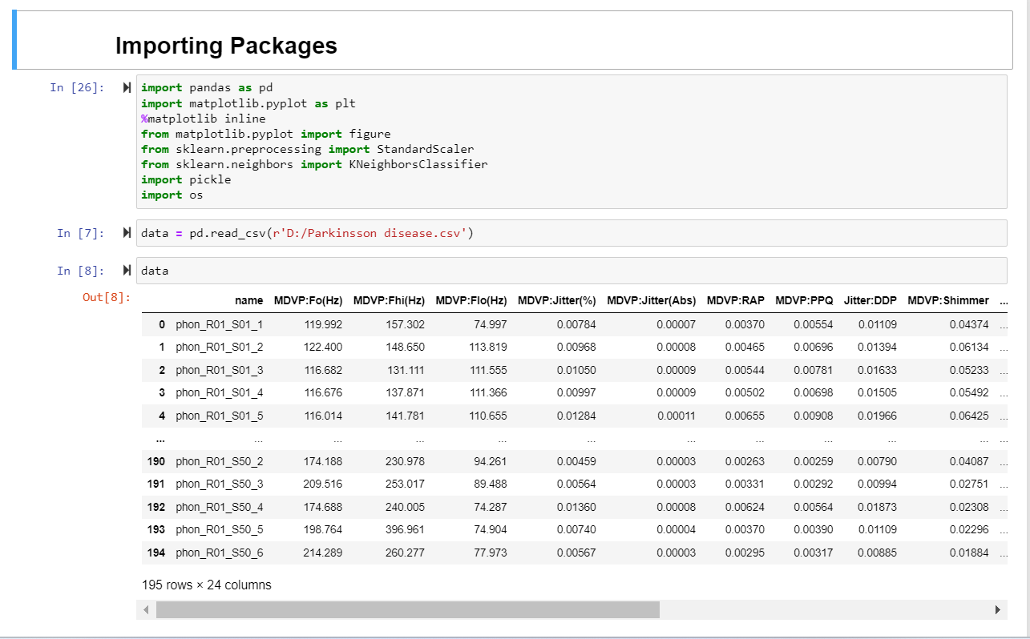
5.Model :

Slide 8
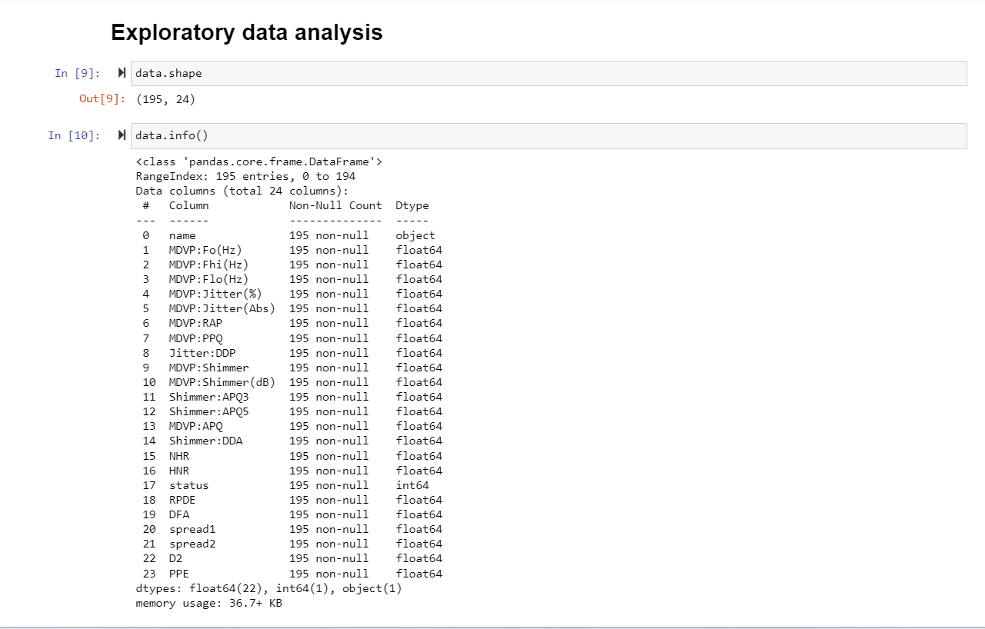

Slide 9
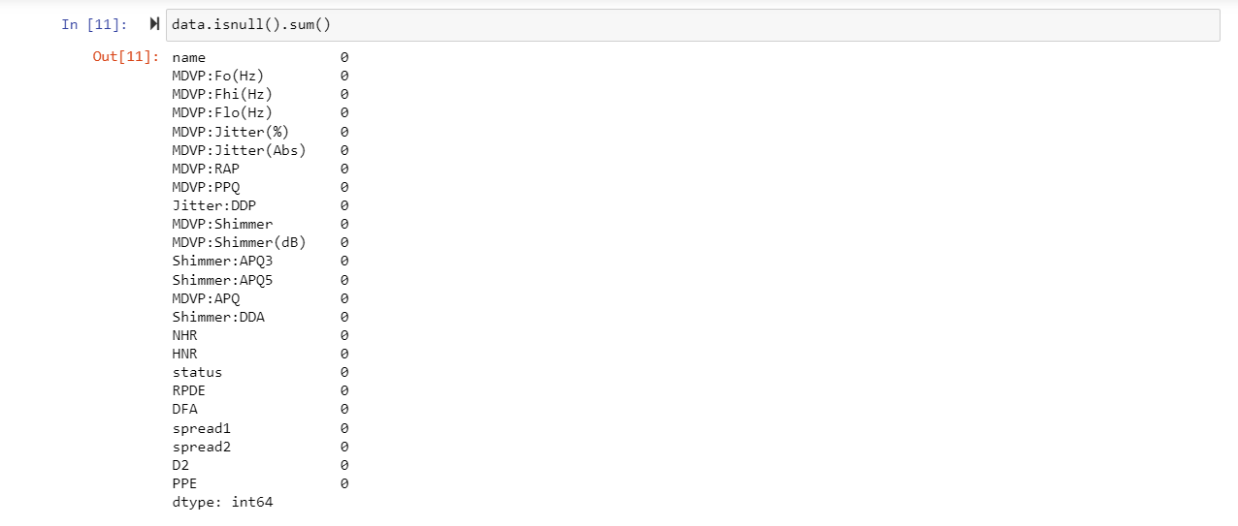

Slide 10
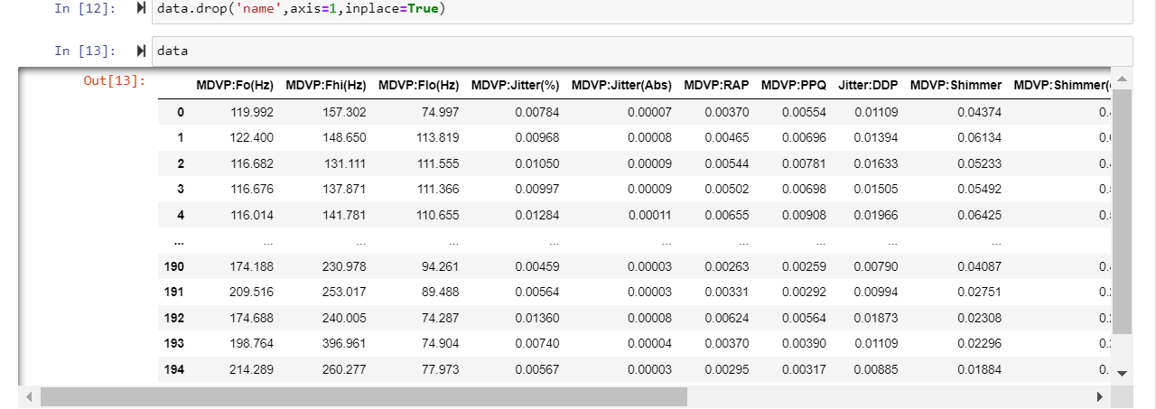

Slide 11
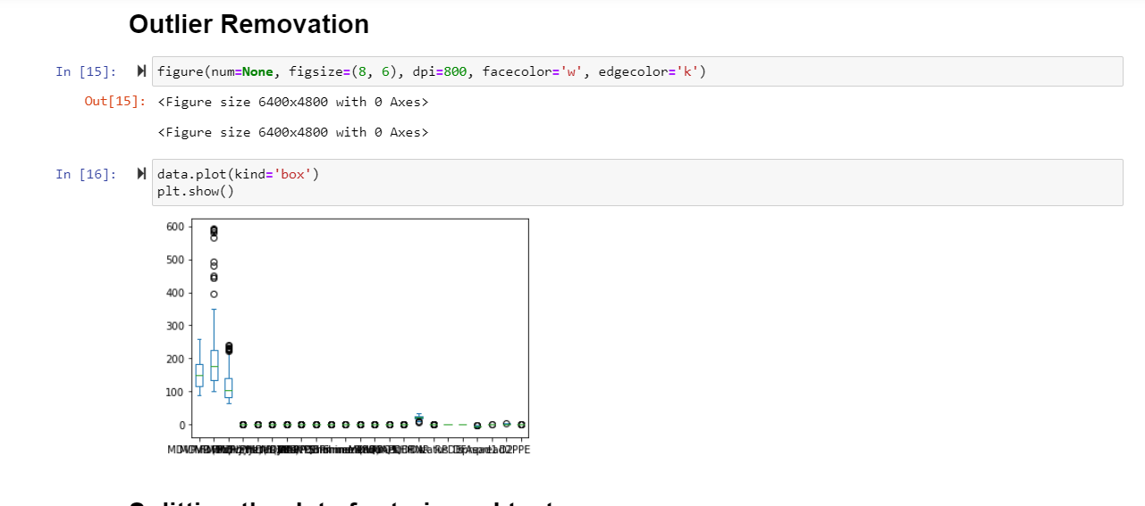

Slide 12
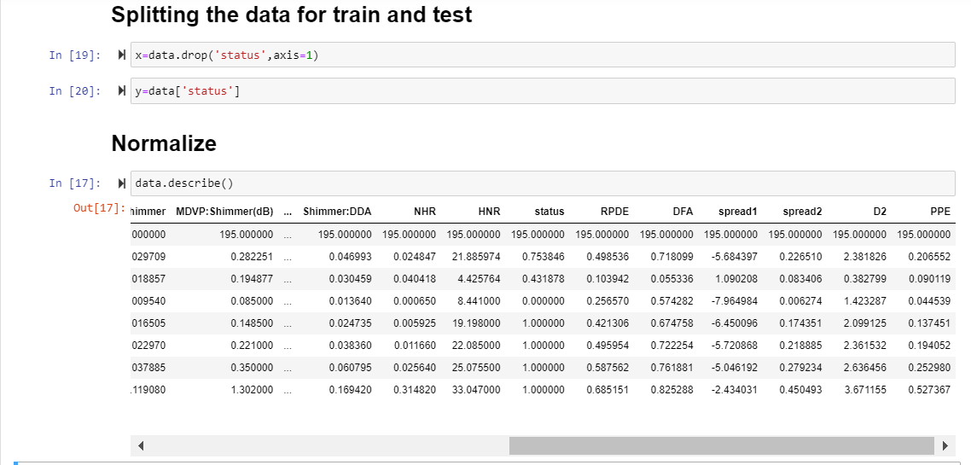

Slide 13
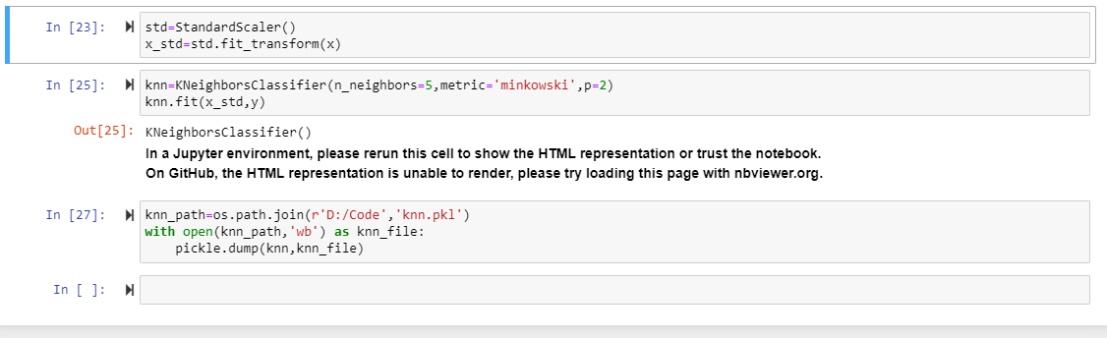

Slide 14
Advantages:
Cost-Effective: Compared to currently available systems for Parkinson’s Disease detection, machine learning-based systems can be faster and cheaper
Early Detection: These systems can potentially detect Parkinson’s Disease at an early stage, which is often challenging with traditional diagnostic approaches
Improved Accuracy: Our provide more accurate results in disease prediction compared to other data taxonomy techniques
Disadvantages:
Limited Access: Not everyone may have access to the necessary technology or internet connectivity required for remote monitoring or diagnosis, potentially leaving certain populations underserved
Continual Updates: These systems require constant updates and improvements to adapt to changes in disease presentation or technology, which can be resource-intensive.

Slide 15
9. Outcome:
Data Collection for Research: Projects may generate valuable data that can be used for further research into Parkinson's disease. This data can contribute to a better understanding of the disease's
Quality of Life Improvement: Early detection and accurate diagnosis can lead to better management of symptoms, ultimately improving the quality of life for individuals living with Parkinson's disease.
Cost Savings: Timely diagnosis and intervention can result in cost savings for healthcare systems and patients by reducing the need for extensive hospitalization and long-term care.
Awareness and Education: Parkinson's disease detection projects can also raise awareness about the condition, its symptoms, and the importance of early diagnosis. Public education initiatives may be an outcome of these projects.
.

Slide 16
10. Acknowledgement:
We would thank our teammates who worked on collecting data .The diligent efforts of them ensured the quality and integrity of the datasets used in this project
11.References:
Kaggle: Your Machine Learning and Data Science Community
GeeksforGeeks - A computer science portal for geeks
Stack Overflow - Where Developers Learn, Share, & Build Careers
12.Conclusion:
In conclusion, a Parkinson's disease detection project leveraging machine learning holds the potential to revolutionize early diagnosis and treatment of this neurodegenerative disorder. By harnessing advanced algorithms and data-driven approaches, such projects aim to provide accurate, timely, and cost-effective solutions, ultimately improving the lives of patients and enhancing our understanding of Parkinson's disease.

Slide 17


